Slide 1
Perceptron &
Artificial Neural Networks
From the biological neuron to Rosenblatt's Perceptron — how machines learned to mimic the mind

Slide 2
What We'll Cover
01
Biological Neuron
02
Artificial Neuron
How nerve cells receive, process & transmit signals
Synapses, summation junction & activation function
03
Activation Functions
04
McCulloch–Pitts Model
Identity, step & threshold functions
The earliest ANN implementation
05
Rosenblatt's Perceptron
06
Linear Separability
Math, classification & decision boundaries
Where the perceptron succeeds — and fails
2

Slide 3
From Machine Learning to Neural Networks
Machine learning mimics the human learning process — a machine performs tasks and improves with experience, just as humans do. Having explored supervised, unsupervised and reinforcement learning,
the next step is to see how the human nervous system itself has been mimicked inside a computer.
Human Learning
Nervous System
Biological Neuron
Artificial Neural Network
Perceptron & Neural Networks
3

Slide 4
The Human Nervous System
The nervous system coordinates every action of the human body by transmitting signals to and from its different parts. It has two main parts:
CNS
PNS
Central Nervous System (CNS)
Peripheral Nervous System
Consists of the brain and spinal cord. It integrates all information, in the form of signals, from the different parts of the body.
Consists of nerves and ganglia outside the brain and spinal cord. It connects the CNS with the limbs and organs.
Perceptron & Neural Networks
4

Slide 5
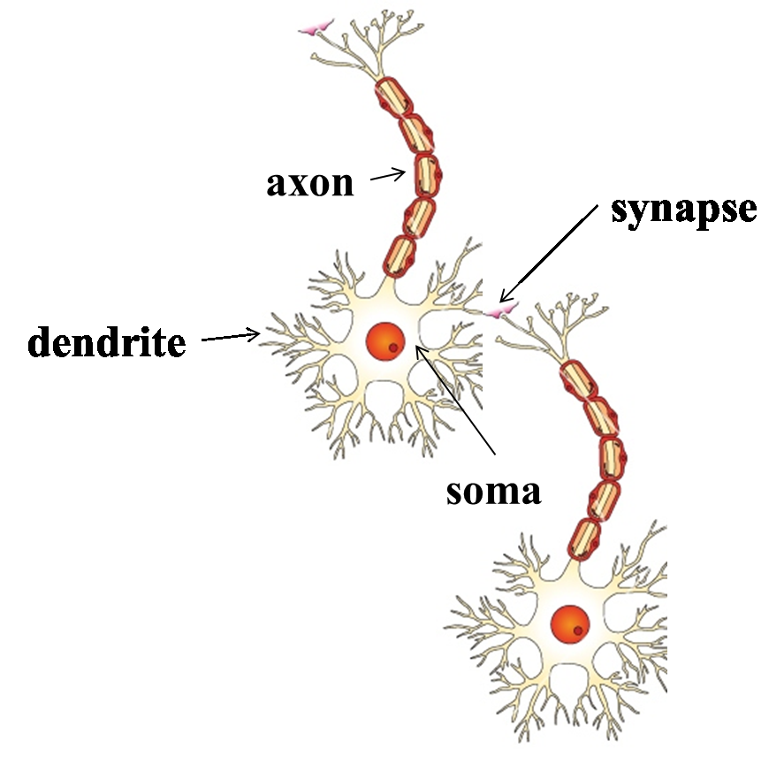
Structure of a Biological Neuron
A neuron receives, processes, and transmits chemical and electrical signals through three main parts:
1
Dendrites
Receive signals from neighbouring neurons.
Soma
2
Soma
Main body that accumulates incoming signals and 'fires' once enough signal has built up.
3
Axon
Carries the fired signal through axon terminals to the dendrites of neighbouring neurons.
The small gap between one neuron's axon terminal and the next neuron's dendrite is the synapse — signals crossing it may be excitatory or inhibitory.
Perceptron & Neural Networks
5

Slide 6
The Brain, By the Numbers
1.3 kg
100 Billion
10¹⁶
10⁵
Weight of the adult
human brain
Neurons (10¹¹) in the
human brain
Total synaptic
connections
Other neurons each
neuron connects to
Glial (glue) cells act as support cells for neurons — roughly 10× more numerous than neurons themselves, which make up only ~10% of all brain cells. Each axon is just 10–12 µm wide, and every synapse spans a gap only about a millionth of an inch.
6

Slide 7
The Birth of Artificial Neural Networks
The fascinating capability of the biological neural network — massive parallel processing built from billions of connected neurons — inspired the invention of the Artificial Neural Network (ANN).
BIO
ANN
An ANN is a machine designed to model the functioning of the nervous system — specifically, the neurons.
Biological Neuron
Artificial Neuron
The biological neuron is replicated in electronic or digital form.
“The only difference is that the biological form of neuron is replicated in the electronic or digital form of neuron.”
Digital / artificial neurons form the smallest processing units of an ANN.
Perceptron & Neural Networks
7

Slide 8
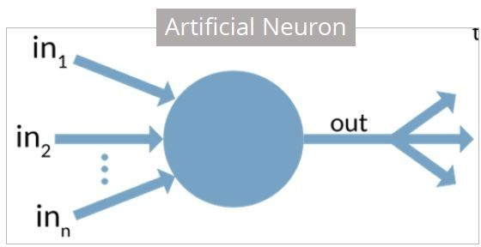
Structure of an Artificial Neuron
Each artificial neuron has three major components:
1
Synapses (weights)
Each input xi connects through a synapse of weight wi. Positive weight = excitatory; negative weight = inhibitory.
2
Summation Junction
A linear combiner that adds the weighted inputs: ysum = Σ wi·xi
3
Activation Function
A 'squashing' function that produces an output only when the signal crosses a threshold: yout = f(ysum)
Perceptron & Neural Networks
8

Slide 9
The Summation Junction
The summation junction is a linear combiner (adder) for all weighted input signals arriving at the neuron.
Without bias
With bias 'b'
y
ysum = b + Σ wi · xi
sum = Σⁿi₌₁ wi · xi
Note: A neural network typically includes a bias which adjusts the input of the activation function. For simplicity, the base model ignores bias, treating it as an additional weighted input.
wi may be positive (excitatory effect) or negative (inhibitory effect) on the output of the summation junction, ysum.
Perceptron & Neural Networks
9

Slide 10
10.3 EXPLORING THE ARTIFICIAL NEURON
The Activation Function
Also called a 'squashing function', the activation function produces an output signal only when the input exceeds a specific threshold value — mirroring how a biological neuron only transmits a signal once its firing threshold is met.
Why 'Squashing'?
1
yout = f( ysum )
The output of the activation function, yout, is the final signal the neuron passes on to the next layer or neuron.
0
threshold
No signal below threshold — full signal once it's crossed.
Perceptron & Neural Networks
10

Slide 11
10.4 TYPES OF ACTIVATION FUNCTIONS
Three Foundational Activation Functions
01
02
03
Identity Function
Step Function
Threshold Function
yout = f(x) = x
1 if x ≥ 0, else 0
1 if x ≥ θ, else 0
Output equals the input exactly — used for the input layer.
Fires (1) for zero or positive input; silent (0) otherwise.
Like the step function, but fires only past a custom threshold θ.
Perceptron & Neural Networks
11

Slide 12
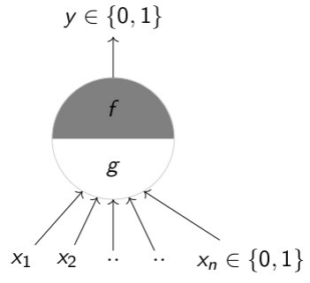
McCulloch-Pitts Neuron Model and Thresholding logic
Proposed by: W. S. McCulloch (neuroscientist) and Walter Pitts (logician) in 1943.
Simplified Neuron Model: Created a basic representation of a neuron as a mathematical model.
Binary Output: The model outputs either 0 (no firing) or 1 (firing), based on input signals.
Input Threshold: Neuron fires when the sum of inputs exceeds a certain threshold.
Logic Function: Modeled neurons using logical operations (AND, OR, etc.).
Impact: The model laid the foundation for artificial neural networks and inspired computational neuroscience.

Slide 13
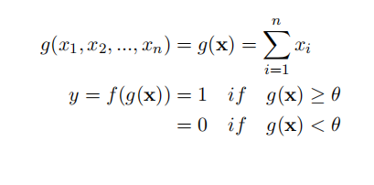
Working of the McCulloch-Pitts Neuron Model
McCulloch (neuroscientist) and Pitts (logician) proposed a highly simplified computational model of the neuron (1943)
g aggregates the inputs and the function f takes a decision based on this aggregation
The inputs can be excitatory or inhibitory
y = 0 if any xi is inhibitory, else excitatory
θ is called the thresholding parameter
This is called Thresholding Logic

Slide 14
Input Signals: The model receives multiple binary input signals (0 or 1).
Summing Function: The model sums the inputs.
Threshold: The sum is compared to a threshold value.
If the sum is greater than or equal to the threshold, the neuron fires (output = 1).
If the sum is less than the threshold, the neuron does not fire (output = 0).
Output: The final result is a binary output (0 or 1) based on the threshold comparison.
Excitatory inputs: increase the sum, pushing the neuron closer to firing.It represented by positive weights (e.g., +1).
Inhibitory inputs:decrease the sum, making it less likely for the neuron to fire.represented by Negative weights (e.g., -1).

Slide 15
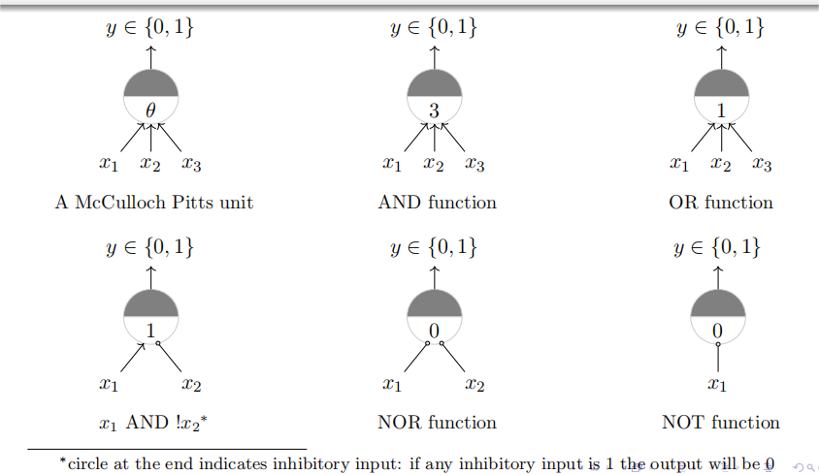
Implementing Boolean Functions with McCulloch-Pitts Neuron Model

Slide 16
10.4.1 & 10.4.2
Identity Function & Step Function
Identity Function
Step Function
yout = f(x) = x, for all x
yout = 1 if x ≥ 0, 0 if x < 0
Used as the activation function for the input layer — the output remains exactly the same as the input, with no transformation applied.
The most commonly used activation function. It gives 1 as output for zero or positive input, and 0 for negative input.
Perceptron & Neural Networks
12

Slide 17
10.4.2 THRESHOLD FUNCTION
The Threshold Function
The threshold function behaves almost like the step function — the only difference is that a custom threshold value θ is used instead of 0.
f(ysum)
yout = f(ysum) =
1, x ≥ θ
0, x < θ
θ (theta) is the threshold value that determines when the neuron 'fires' — this is the same concept the McCulloch–Pitts model builds on.
θ
Perceptron & Neural Networks
13

Slide 18
10.5.1 MCCULLOCH–PITTS — WORKED EXAMPLE
Does John Carry an Umbrella?
John carries an umbrella if it is sunny OR if it is raining. Using x1 = 'Is it raining?' and x2 = 'Is it sunny?', both weights are set to 1 and the threshold to 1.
Situation
x1
x2
ysum
yout
1 — no rain, no sun
0
0
0
0
x1
1
2 — sunny only
0
1
1
1
Σ
⊢1
yout
3 — raining only
1
0
1
1
x2
1
4 — both
1
1
2
1
yout = 1 → John carries the umbrella
The result is the logical OR function — implemented purely through weights and a threshold.
Perceptron & Neural Networks
15

Slide 19
Rosenblatt's Perceptron
Built around the McCulloch–Pitts neural model, Rosenblatt's perceptron receives a set of inputs x1, x2, …, xn, computes their weighted sum, and passes it through a hard limiter.
x0 = 1
Goal
x1
Σ
v
f(v)
Classify inputs into two classes, c1 and c2, using a simple decision rule based on the sign of yout.
yout
x2
Linear
Combiner
Hard
Limiter
xn
yout = +1 ⟶ c1
yout = −1 ⟶ c2
An adjustable bias w0 is attached to a dummy input x0 (always = 1), letting the decision boundary shift instead of always passing through the origin.
Perceptron & Neural Networks
16

Slide 20
10.5.1 ROSENBLATT'S PERCEPTRON — EXAMPLE
Classifying Points With the Perceptron
Using boundary 2x1 + x2 = 8 (w0=−2, w1=½, w2=¼): p1(5,2) and p2(−1,12) belong to c1; p3(3,−5) and p4(−2,−1) belong to c2.
Point
v = Σ wixi
yout
Class
Class c1 (above boundary) • Class c2 (below boundary)
p1 = (5, 2)
−2+½(5)+¼(2) = 1
1
c1
p2
boundary
p2 = (−1, 12)
−2+½(−1)+¼(12) = 0.5
1
c1
p1
p3 = (3, −5)
−2+½(3)+¼(−5) = −1.75
0
c2
p4 = (−2, −1)
−2+½(−2)+¼(−1) = −3.25
0
c2
p4
p3
Perceptron & Neural Networks
18

Slide 21
Feature | McCulloch-Pitts Neuron | Perceptron
Purpose | Theoretical neuron model | Binary classification
Inputs | Binary (0 or 1) | Real-valued
Weights | Fixed, predefined | Learnable via training
Bias | Not included | Included
Learning Mechanism | None | Yes (supervised learning)
Output | Binary (0 or 1) | Binary (0 or 1)

Slide 22
10.5.1 PERCEPTRON — ASSUMPTIONS & LIMITS
Linear Separability: The Perceptron's Boundary
For synaptic weights to be found appropriately, one key assumption must hold: the training data's classes must be linearly separable.
✓ Linearly Separable
✗ Non-Linearly Separable
A single straight line (or hyperplane) can fully separate class c1 from class c2 — the perceptron can solve this.
Interlocking / curved regions cannot be split by any single straight line — the classification problem cannot be solved by a perceptron alone.
Perceptron & Neural Networks
19

Slide 23
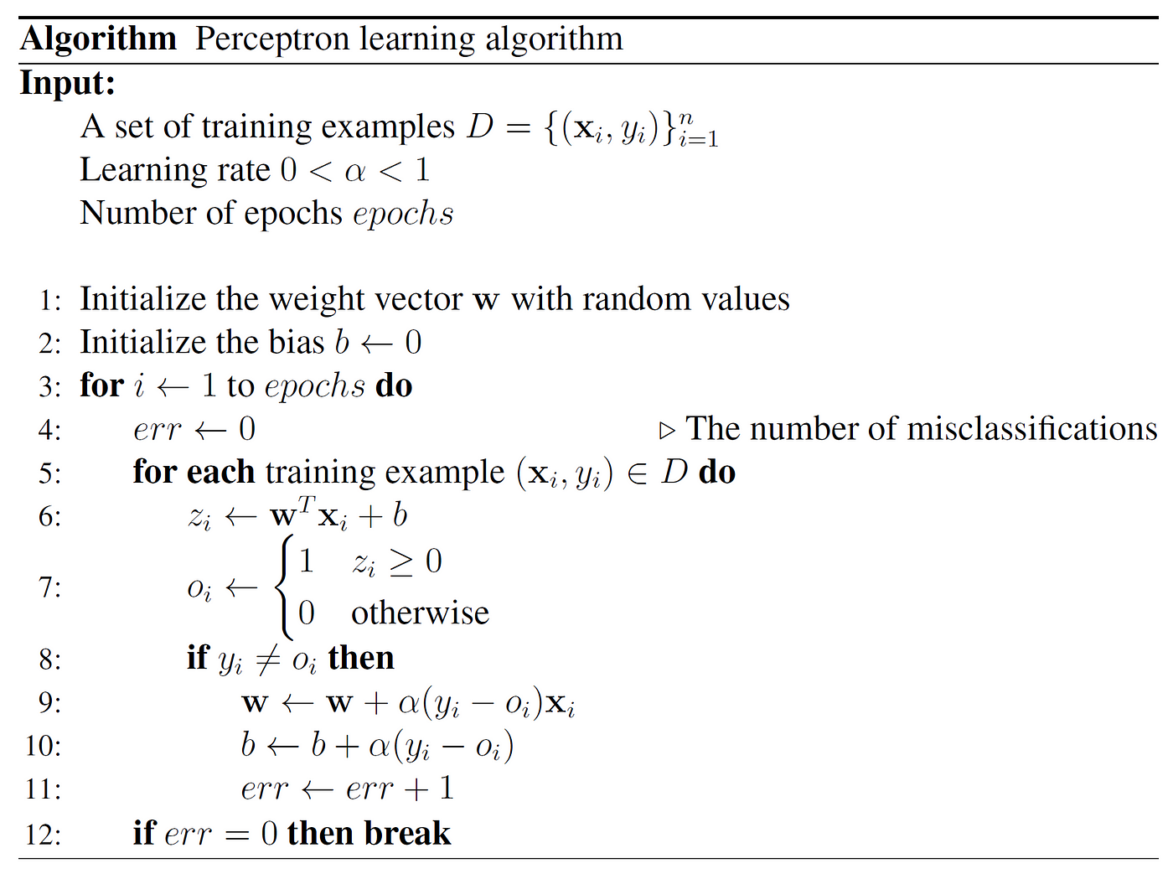
Perceptron Learning Algorithm

Slide 24
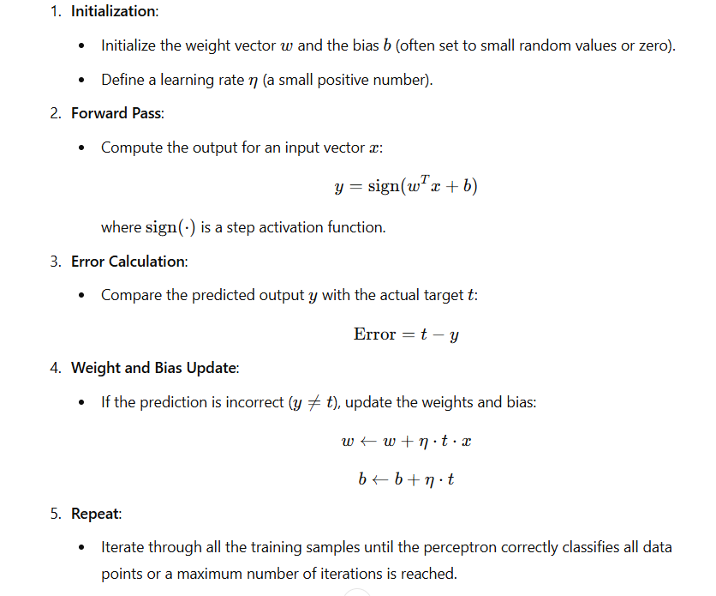
Perceptron Learning Algorithm

Slide 25
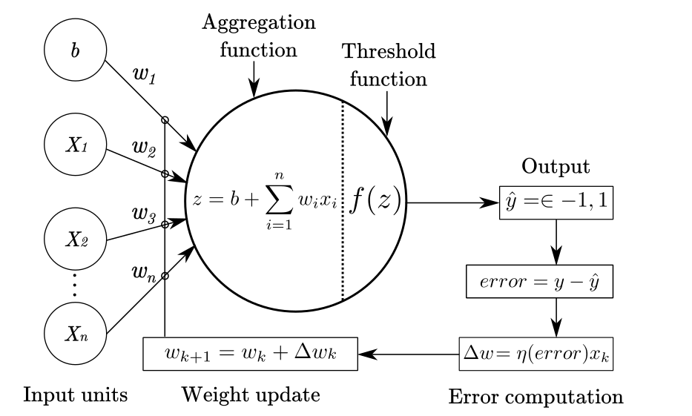

Slide 26
Strengths of Perceptron
Simple Architecture: Easy to understand and implement.
Fast Training: Learns quickly with lightweight computations.
Linearly Separable Data: Works effectively when classes can be separated by a straight line.
Low Resource Requirement: Requires less memory and computational power.
Suitable for Small Datasets: Can be efficiently used with simple and small datasets.
Foundation for Deep Learning: Forms the basic concept behind multilayer neural networks.

Slide 27
Limitations of Perceptron
No Non-Linear Learning: Cannot solve complex problems like XOR.
Binary Output: Mainly designed for two-class classification.
No Hidden Layers: Cannot learn complex or abstract patterns.
Sensitive to Feature Scaling: Works better when input features are properly normalized.
Limited Real-World Applications: Too simple for complex tasks such as image recognition and NLP.

Slide 28
Applications
Binary Classification: Used for simple Yes/No or two-class problems.
Logic Gate Modeling: Can implement gates such as AND and NAND.
Simple Pattern Recognition: Identifies patterns that are linearly separable.
Feature Importance: Weights show how strongly each feature influences the output.
Educational Purpose: Helps in understanding the basics of neural networks and machine learning.

